Slide 1
Internet of Things with Intel A1 – What is IoT ?
paul.guermonprez@intel.com

Slide 2
What is IoT ?

Slide 3
Internet of Things
Many definitions, but main characteristics of IoT are :
Highly connected
Smart
Thing = Not a computer / phone / tablet
Network/physical world interface

Slide 4
Highly connected
Can be internet of course, but can also be :
Intermittent internet (to save power, or because it’s unavailable)
Low bandwidth, long distance (Sigfox)
Mesh networks
Local : Bluetooth Low Energy BLE, ZigBee
The “Internet” of IoT is not your usual Internet.

Slide 5
Smart
Smart does not mean the raw information is smart or coming from an ultra precise sensor.
Your solution will be smart if :
You cross analyze data from basic sensors
You perform a first level of AI locally
You improve your solution with a central AI
It works with an imperfect connectivity
Don’t wait for the perfect sensor.

Slide 6
Thing
A laptop will use 90% of your brain : It’s designed as an exclusive tool.
A modern touch phone : 40% You can walk, but not drive safely.
An old phone with keys : 20%
IoT solutions : target 0-5% maximum

Slide 7
Thing
Why 0-5% maximum ?
You may have 50 of them at home. You don’t have time for each of them.
You don’t want to think while you interact with them. Natural interfaces are better.
The best interaction : no active interaction.
No screen, no settings, limited features.

Slide 8
Physical world / Network
An embedded project may not be IoT if :
no information is gathered from the environment by analog or digital sensors
no physical action is taken by motors, lights, sound, …
Plan to interact with the physical world

Slide 9
Why IoT ?

Slide 10
Why deploy IoT solutions ?
To optimize : an automated air conditioning system could improve your daily life.
But it can also allow the electricity company to limit your power consumption during summer peak days.
20% cheaper electricity all year to allow the electricity company to limit by 10% your consumption during 3 peak days a year ?
… why not :-)
Think hardware + software data service rather than just hardware.

Slide 11
Why deploy IoT solutions ?
To collect data : Internet access and communications are already highly monitored to characterize your behavior.
But the physical world is not, except for GPS.
Knowing everything about your electrical devices, consumptions, movements at home has a lot of value.
Happy ? … maybe not :-(
Just like with mobile devices, a lot of IoT devices will collect data.

Slide 12
Fields of IoT

Slide 13
Fields of IoT
Wearable

Slide 14
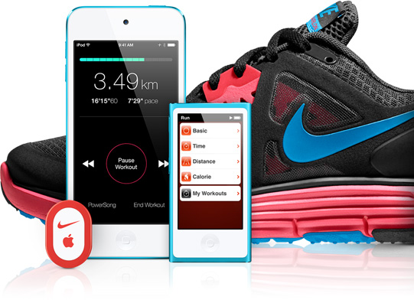




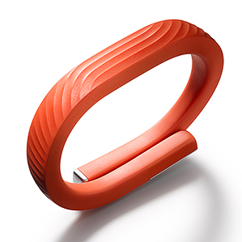
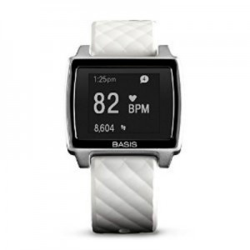
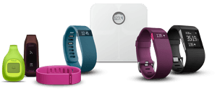
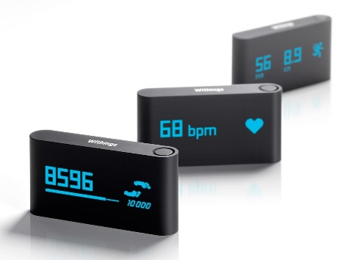
Quantified self
Form : Stuff you wear, minimal interaction, often connected your phone but not your typical mobile device.
Motivations : body/health information.

Slide 15
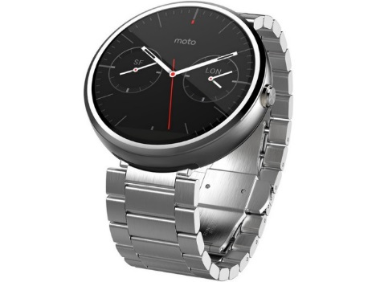
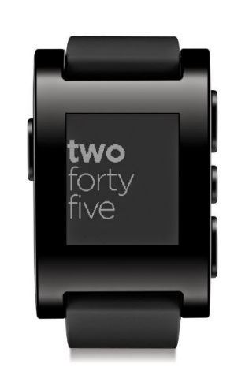
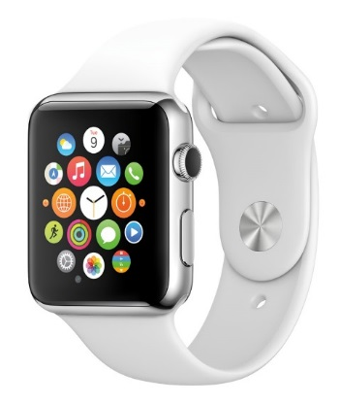
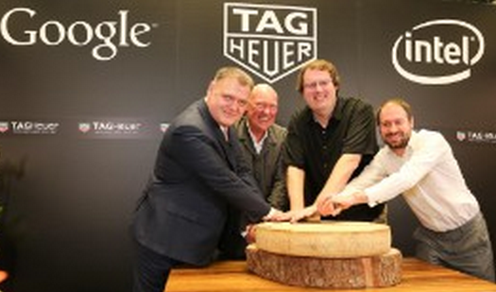
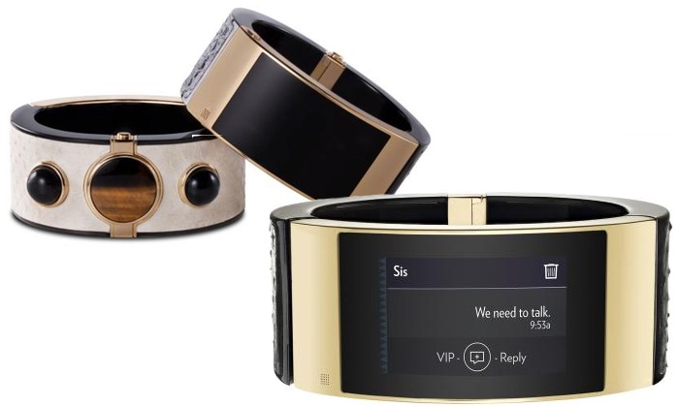
Wearable - Watches
Wearable … but not really an IoT. More like a mobile device. Note :
Intel/TagHeuer/Google collaboration.
Intel MICA Smartband.

Slide 16
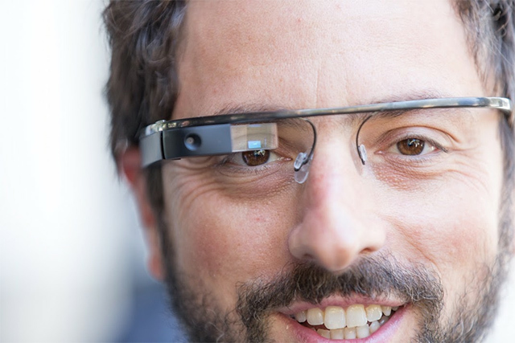
Wearable - Glasses

Slide 17
Fields of IoT
Smart building / Home automation

Slide 18
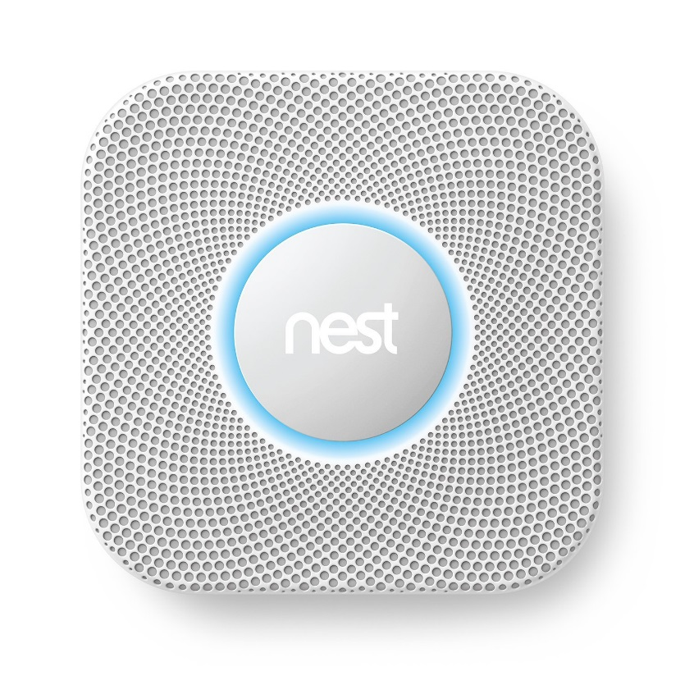
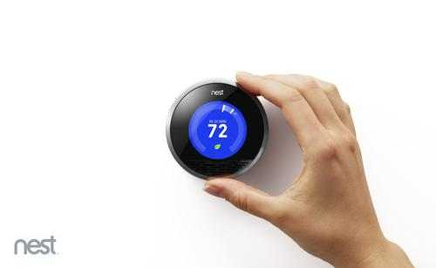
Google - Nest

Slide 19
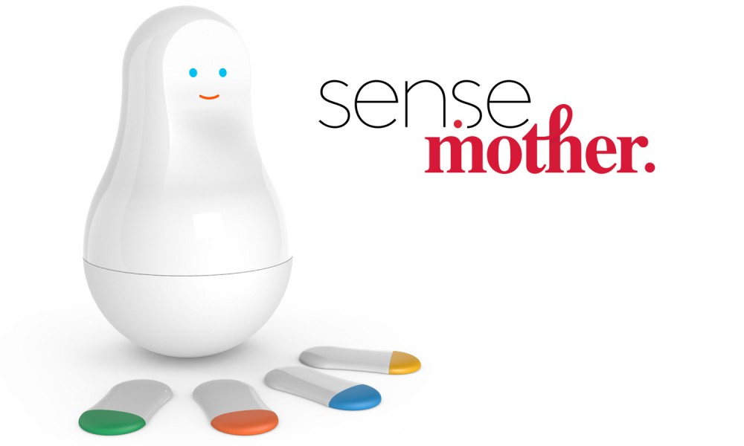
Sen.se

Slide 20
Fields of IoT
Non humanoid robots and drones

Slide 21
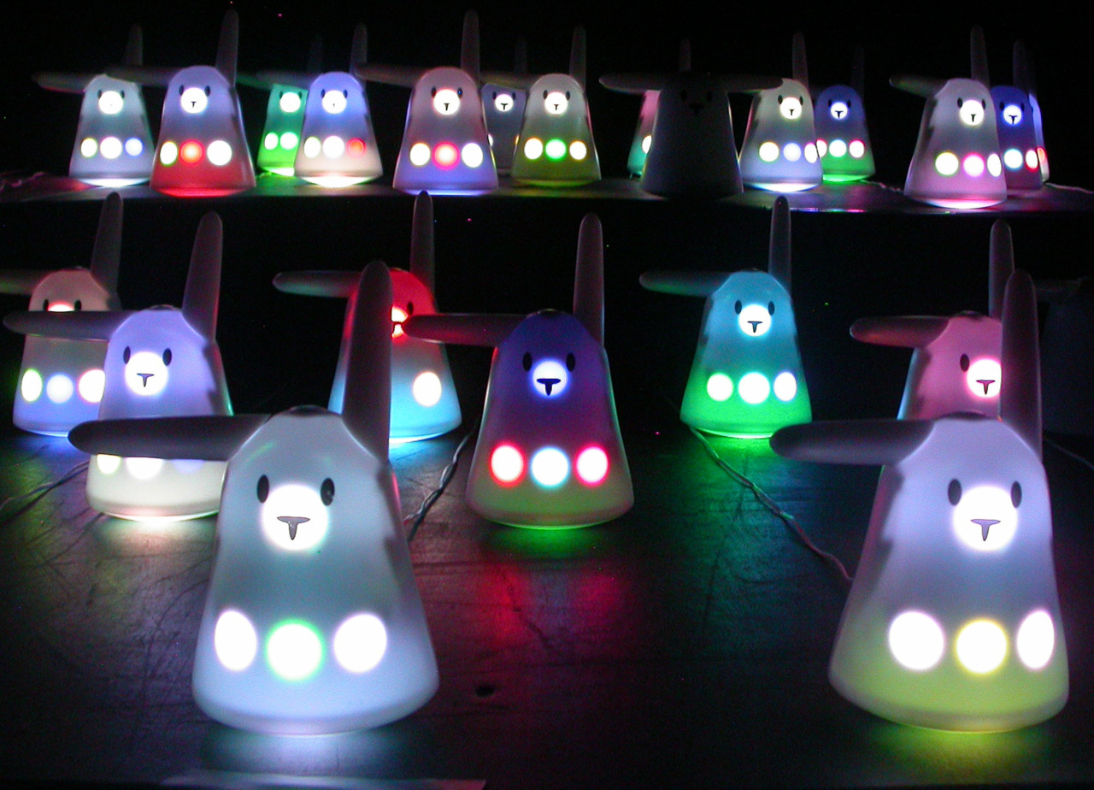
Nabaztag

Slide 22
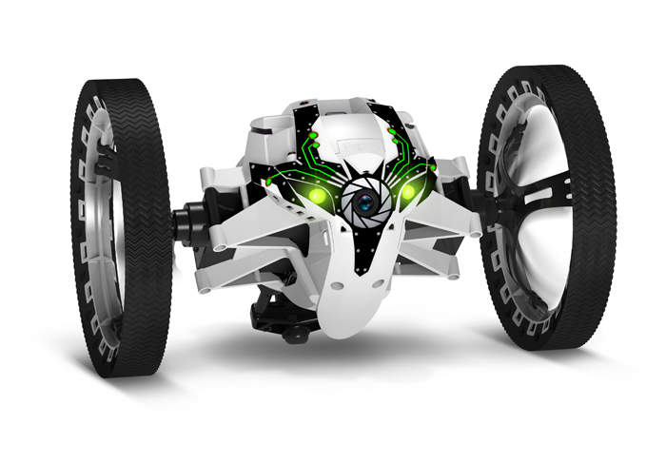
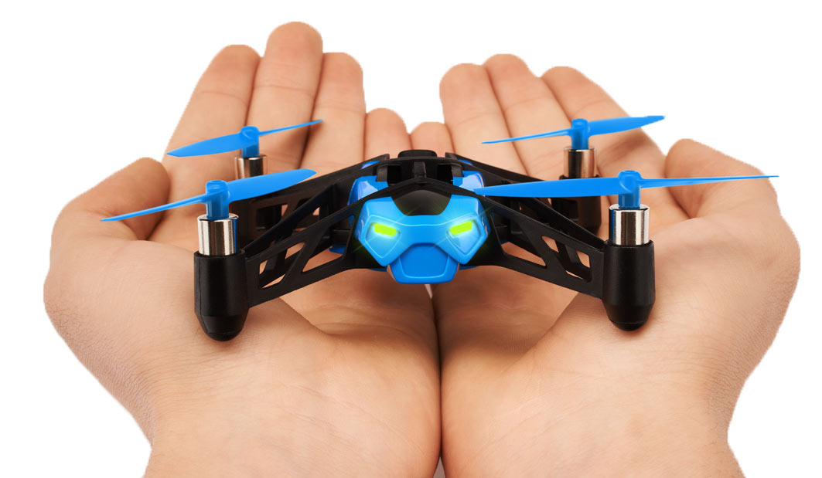
Parrot Minidrones

Slide 23
Fields of IoT
Embedded – Old is New

Slide 24
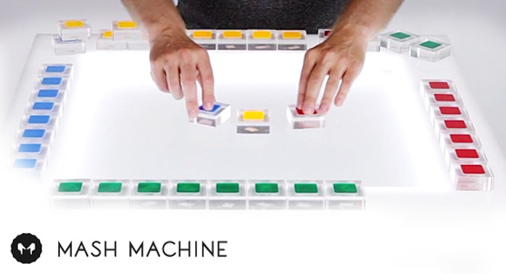
Arcade / smart surfaces

Slide 25
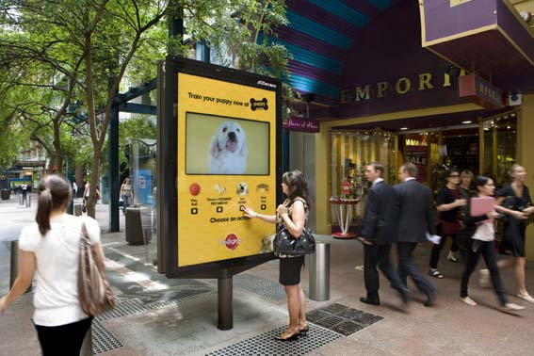
Digital signage / Smart furniture

Slide 26
Fields of IoT
For the fun, the lulz

Slide 27
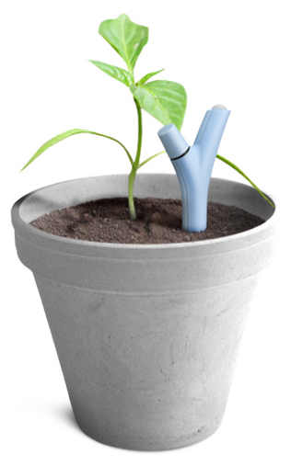

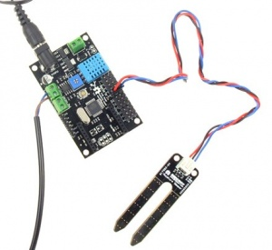
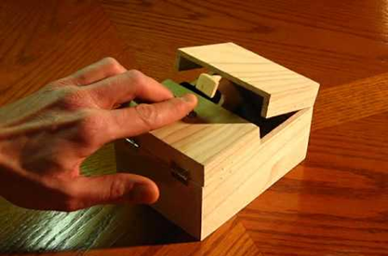
Why ? Because you can !

Slide 28
Links
Get the video recording of this lecture and sample codes from :
https://github.com/guermonprez/intel-academic-IoT-course
https://www.youtube.com/playlist?list=PLFBM-eCNdj6A5VSmOEjpn8XoiM88398B7
http://software.intel.com/academic/iot/
Please send feedback and questions to :
paul.guermonprez@intel.com

Slide 29
License Creative Commons – By 3.0
You are free:
to Share — to copy, distribute and transmit the work
to Remix — to adapt the work
to make commercial use of the work
Under the following conditions:
Attribution — You must attribute the work in the manner specified by the author or licensor (but not in any way that suggests that they endorse you or your use of the work).
With the understanding that:
Waiver — Any of the above conditions can be waived if you get permission from the copyright holder.
Public Domain — Where the work or any of its elements is in the public domain under applicable law, that status is in no way affected by the license.
Other Rights — In no way are any of the following rights affected by the license:
Your fair dealing or fair use rights, or other applicable copyright exceptions and limitations;
The author's moral rights;
Rights other persons may have either in the work itself or in how the work is used, such as publicity or privacy rights.
Notice — For any reuse or distribution, you must make clear to others the license terms of this work. The best way to do this is with a link to this web page.
http://creativecommons.org/licenses/by/3.0/

